Slide 1

Artificial Intelligence
Search
Slides by Dan Klein, Pieter Abbeel, Anca Dragan (ai.berkeley.edu)
Notes:
Please retain proper attribution, including the reference to ai.berkeley.edu. Thanks!
Introduce self again.
Build agents that plans ahead. Act rationally.

Slide 2
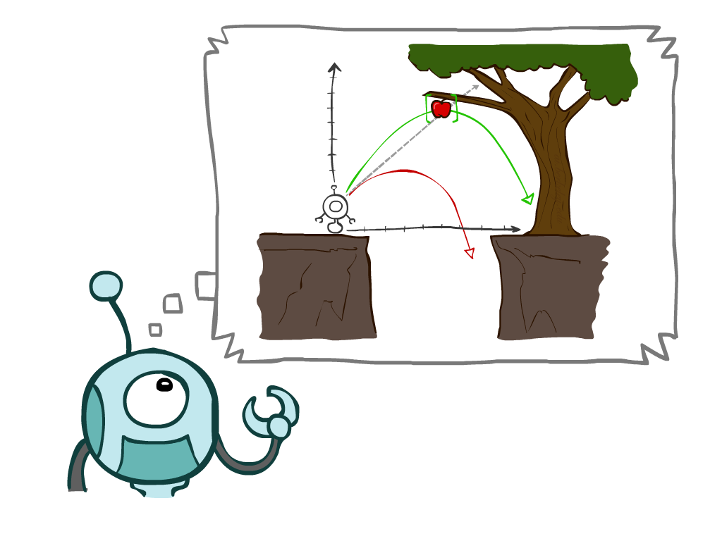
Today
Agents that Plan Ahead
Search Problems
Uninformed Search Methods
Depth-First Search
Breadth-First Search
Uniform-Cost Search
Notes:
Many you have seen before.
Unified formalism leading to A* search (search guided by heuristic)

Slide 3
Agents that Plan
Why agents plan? If/then code. Hard to do.
Move to the apple
Notes:
Why agents plan? If/then code. Hard to do.
Move to the apple

Slide 4

Reflex Agents
Fall; bad idea;
Reflex – lookup from state to action. Don’t consider the future consequences of your actions
Examples: blinking your eye (not using your entire thinking capabilities), vacuum cleaner moving towards nearest dirt
Notes:
Fall; bad idea;
Reflex – lookup from state to action. Don’t consider the future consequences of your actions
Examples: blinking your eye (not using your entire thinking capabilities), vacuum cleaner moving towards nearest dirt
Can a reflex agent be rational?

Slide 5
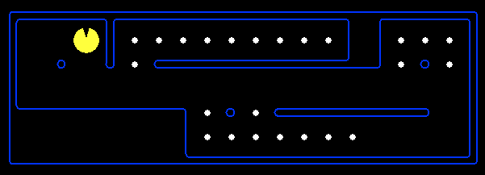
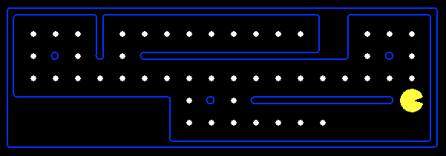
Reflex Agents
Reflex agents:
Choose action based on current percept (and maybe memory)
May have memory or a model of the world’s current state
Do not consider the future consequences of their actions
Can a reflex agent be rational?
Consider how the world IS
Notes:
Fall; bad idea;
Reflex – lookup from state to action. Don’t consider the future consequences of your actions
Examples: blinking your eye (not using your entire thinking capabilities), vacuum cleaner moving towards nearest dirt
Can a reflex agent be rational?

Slide 6
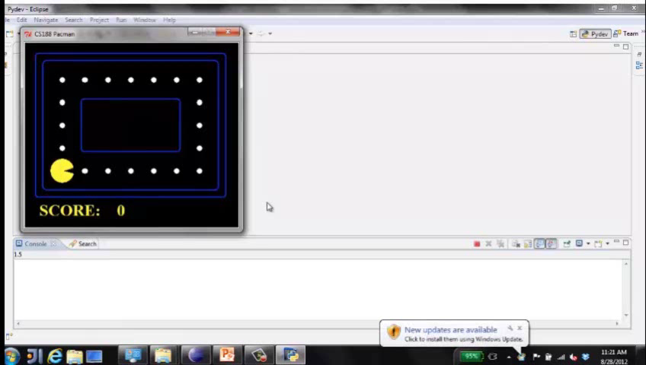
Video of Demo Reflex Optimal
Move in the direction of the nearest uneaten dot. You can think ahead all you want, still end up doing the same thing.
Can be rational.
Notes:
L2D1
Move in the direction of the nearest uneaten dot. You can think ahead all you want, still end up doing the same thing.
Can be rational.

Slide 7
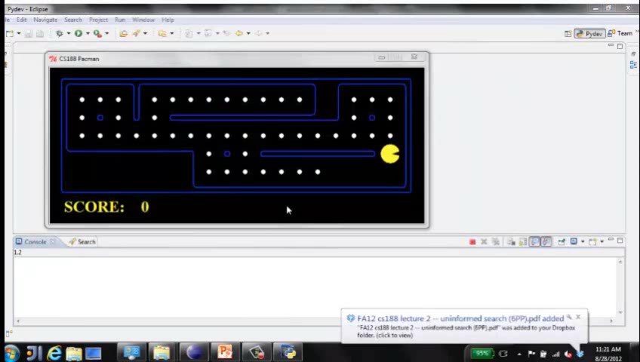
Video of Demo Reflex Odd
NO planning. Wall between you and nearest dot?
Reflex agents not generally optimal, but they can be depending on circumstance.
Optimality is not defined by algorithm, but by rational behavior.
Notes:
L2D2
NO planning. Wall between you and nearest dot?
Reflex agents not generally optimal, but they can be depending on circumstance.
Optimality is not defined by algorithm, but by rational behavior.

Slide 8
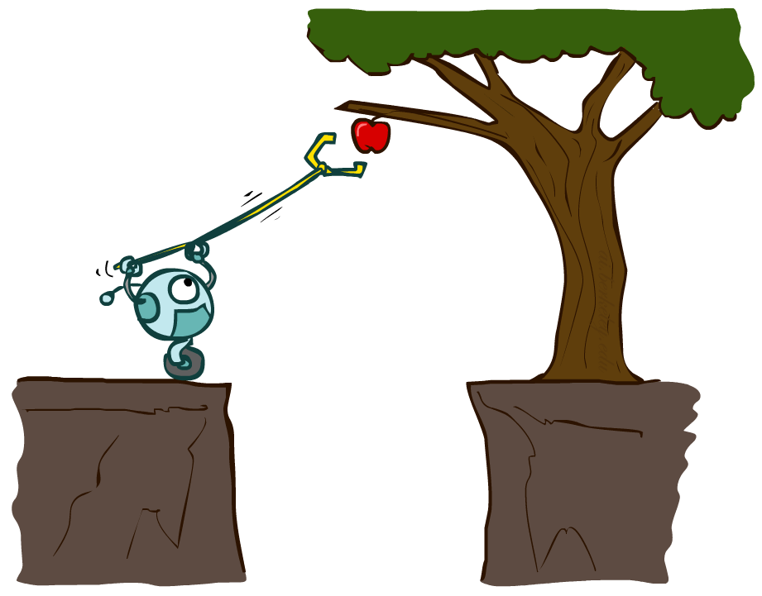
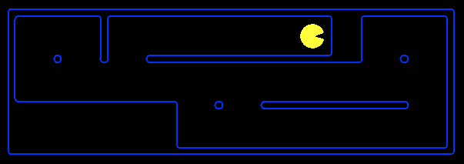
Planning Agents
Planning agents:
Ask “what if”
Decisions based on (hypothesized) consequences of actions
Must have a model of how the world evolves in response to actions
Must formulate a goal (test)
Consider how the world WOULD BE
Optimal vs. complete planning
Planning vs. replanning
You cold figure out the consequences by doing it. But instead, planning considers what the world would be without actually doing it.
Simulate many games, execute one. Doesn’t do it in the world, does it in the model.
Consequences of action.
Complete – a solution; optimal – best
Notes:
You cold figure out the consequences by doing it. But instead, planning considers what the world would be without actually doing it.
Simulate many games, execute one. Doesn’t do it in the world, does it in the model.
Consequences of action.
Complete – a solution; optimal – best

Slide 9
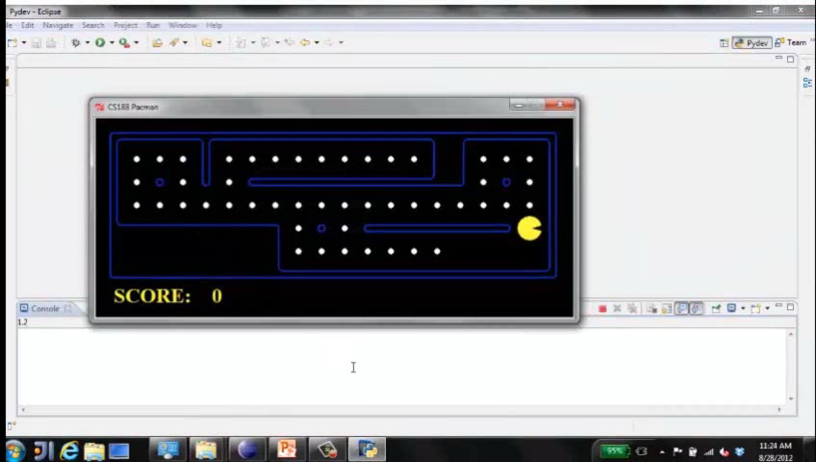
Video of Demo Replanning
Notes:
L2D3, replanning. Figure out how to get to next dot. Clears board; non-optimal. Fast.

Slide 10
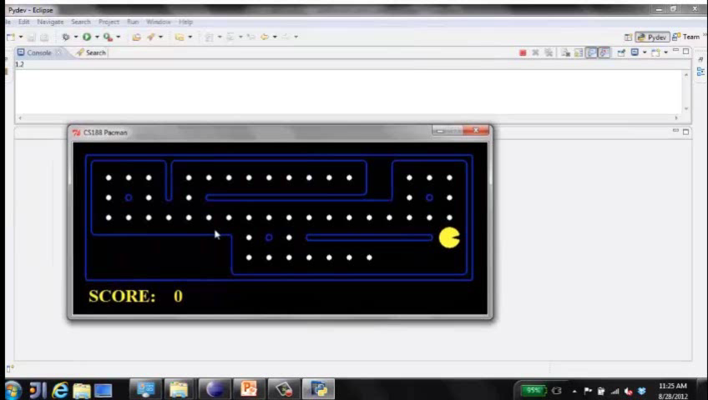
Video of Demo Mastermind
Notes:
L2D4, mastermind. Thinking, thinking, thinking…
Not just clear NEXT dot, but all dots.
Know to end with dead end so it doesnt have to back up

Slide 11

Search Problems
How do we formalize a search problem?
Notes:
How do we formalize a search problem?

Slide 12

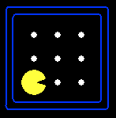





Search Problems
A search problem consists of:
A state space
A successor function
(with actions, costs)
A start state and a goal test
A solution is a sequence of actions (a plan) which transforms the start state to a goal state
“N”, 1.0
“E”, 1.0
Notes:
Abstraction. Useful for later topics.
Goal test – sometimes more than one state that satisfies having achieved the goal, for example, “eat all the dots”

Slide 13

Search Problems Are Models
Models aren’t perfect.
Too detailed, you can’t solve.
Not detailed enough, doesn’t solve.
Notes:
Models aren’t perfect.
Too detailed, you can’t solve.
Not detailed enough, doesn’t solve.

Slide 14
Example: Traveling in Romania
State space:
Cities
Successor function:
Roads: Go to adjacent city with cost = distance
Start state:
Arad
Goal test:
Is state == Bucharest?
Solution?
Notes:
Traffic, gas, accidents, time of day, etc.
Bit of art figuring out state space, etc.

Slide 15
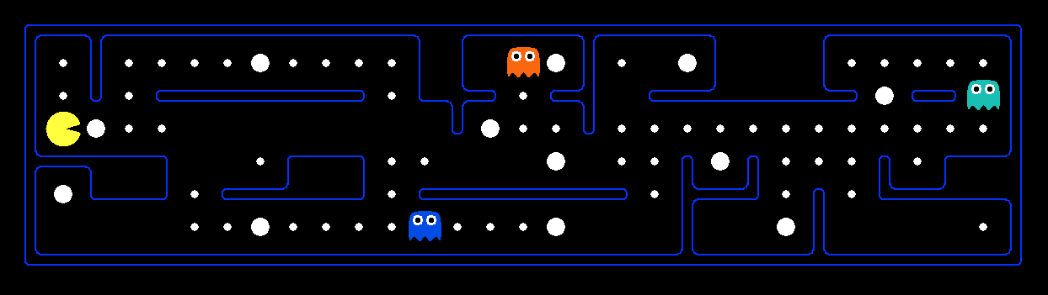
What’s in a State Space?
The world state includes every last detail of the environment
A search state keeps only the details needed for planning (abstraction)
Problem: Pathing
States: (x,y) location
Actions: NSEW
Successor: update location only
Goal test: is (x,y)=END
Problem: Eat-All-Dots
States: {(x,y), dot booleans}
Actions: NSEW
Successor: update location and possibly a dot boolean
Goal test: dots all false
Notes:
Wrong example for “eat-all-dots”: (x, y, dot count). Need bool.
World >= State
Walls? Part of successor.

Slide 16
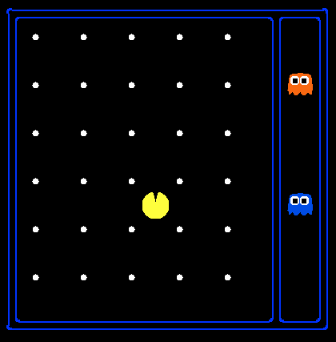
State Space Sizes?
World state:
Agent positions: 120
Food count: 30
Ghost positions: 12
Agent facing: NSEW
How many
World states?
120x(2³⁰)x(12²)x4
States for pathing?
120
States for eat-all-dots?
120x(2³⁰)
Notes:
12x10 grid

Slide 17
Safe Passage
Problem: eat all dots while keeping the ghosts perma-scared
What does the state space have to specify?
(agent position, dot booleans, power pellet booleans, remaining scared time)
Notes:
Eat power pellets. Ignore ghost reset. What do you need in state space?
Do you need ghost positions?
What’s in the state vs. successor function?

Slide 18

State Space Graphs and Search Trees
Notes:
~30 minutes
Solving only uses state space, successor, etc. Not power pellets, dots, etc.

Slide 19
State Space Graphs
State space graph: A mathematical representation of a search problem
Nodes are (abstracted) world configurations
Arcs represent successors (action results)
The goal test is a set of goal nodes (maybe only one)
In a state space graph, each state occurs only once!
We can rarely build this full graph in memory (it’s too big), but it’s a useful idea
Notes:
ASR: every possible pronunciation of every possible sentence. Huge.

Slide 20
State Space Graphs
State space graph: A mathematical representation of a search problem
Nodes are (abstracted) world configurations
Arcs represent successors (action results)
The goal test is a set of goal nodes (maybe only one)
In a search graph, each state occurs only once!
We can rarely build this full graph in memory (it’s too big), but it’s a useful idea
a
G
b
c
e
d
f
S
h
p
q
r
Tiny search graph for a tiny search problem
Notes:
Find solution without writing most of the graph down.
really care about the start and what you can do from the start -> search tree

Slide 21
Search Trees
This is now / start
“N”, 1.0
“E”, 1.0
Possible futures
A search tree:
A “what if” tree of plans and their outcomes
The start state is the root node
Children correspond to successors
Nodes show states, but correspond to PLANS that achieve those states
For most problems, we can never actually build the whole tree
Notes:
Different plans that achieve the same state, will be different nodes in the tree.
Every plan in the tree.
Search ignores most of the tree.

Slide 22
State Space Graphs vs. Search Trees
State Space Graph
Each NODE in in the search tree is an entire PATH in the state space graph.
Search Tree
S
a
G
d
e
p
b
c
q
b
c
e
h
r
d
e
f
a
a
h
r
p
q
f
S
h
We construct both on demand – and we construct as little as possible.
p
q
f
q
c
G
p
q
r
q
c
G
a
a

Slide 23

State Space Graphs vs. Search Trees
Consider this 4-state graph:
How big is its search tree (from S)?
a
s
a
b
S
G
b
G
a
G
b
a
G
b
G
…
…
Important: Lots of repeated structure in the search tree!
Notes:
Graph is only 4, tree is infinite!

Slide 24
Tree Search algorithm
Notes:
That’s the abstraction. Now talk about algorithm.

Slide 25
Search Example: Romania

Slide 26
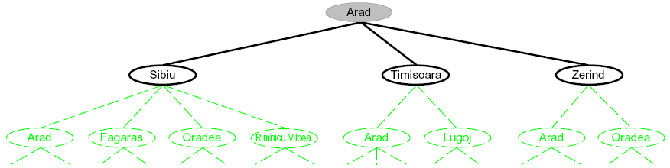
Searching with a Search Tree
Search:
Expand out potential plans (tree nodes)
Maintain a fringe of partial plans under consideration
Try to expand as few tree nodes as possible
Notes:
Haven’t constructed green stuff yet. It exists and is mathematically defined, but we haven’t actually constructed it / explored it yet.
Build downward.

Slide 27
General Tree Search
Important ideas:
Fringe
Expansion
Exploration strategy
Main question: which fringe nodes to explore?
Notes:
Pseudo-code. General algorithm. Some details specific to later topics, notably A*.

Slide 28
Example: Tree Search
a
G
b
c
d
e
f
S
h
p
q
r
Notes:
Tiny example. Here’s the state graph. Walk through tree search.
Left: show tree. Not typically stored, but implicit.
Right: fringe. Key data structure.

Slide 29
Example: Tree Search
a
G
b
c
e
d
e
d
f
f
S
h
p
r
q
r
S
s
s → d
s → e
s → p
s → d → b
s → d → c
s → d → e
s → d → e → h
s → d → e → r
s → d → e → r → f
s → d → e → r → f → c
s → d → e → r → f → G
d
e
p
b
c
e
h
r
q
a
a
h
r
p
q
f
p
q
f
q
c
G
q
c
G
a
a
Notes:
For example, strategy is arbitrary.
S D E R F G
Don’t return until G removed. Not when G added. Important later.
188-guided-search; in general we don’t have 188 on call to tell us what to expand next

Slide 30

Depth-First Search
Notes:
That was generic. Now specific strategy – dfs
Go deep!
Exponentially large at the bottom.

Slide 31

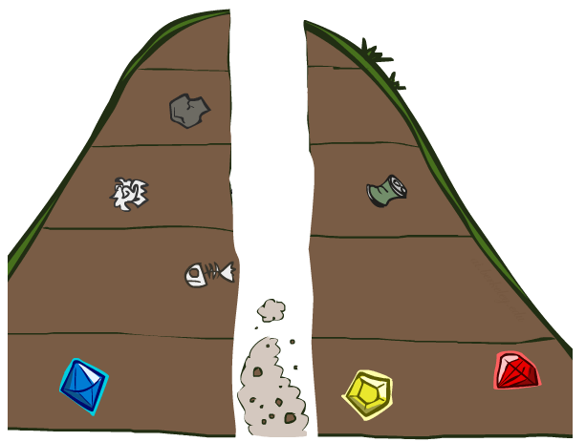

Slide 32
Depth-First Search
Strategy: expand a deepest node first
Implementation: Fringe is a LIFO stack
a
G
a
c
b
c
b
e
d
e
d
f
f
S
h
h
p
p
r
q
r
q
S
d
e
p
b
c
e
h
r
q
a
a
h
r
p
q
f
p
q
f
q
c
G
q
c
G
a
a
Notes:
S D B A C A E H P Q
Ties alphabetically in this case.

Slide 33
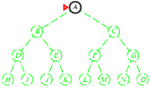
Depth-first search
Expand deepest unexpanded node
Implementation:
LIFO queue, i.e., put successors at front

Slide 34
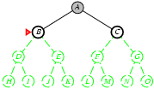
Depth-first search
Expand deepest unexpanded node
Implementation:
LIFO queue, i.e., put successors at front

Slide 35
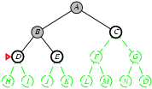
Depth-first search
Expand deepest unexpanded node
Implementation:
LIFO queue, i.e., put successors at front

Slide 36
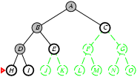
Depth-first search
Expand deepest unexpanded node
Implementation:
frontier = LIFO queue, i.e., put successors at front

Slide 37
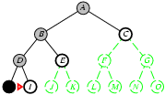
Depth-first search
Expand deepest unexpanded node
Implementation:
LIFO queue, i.e., put successors at front

Slide 38
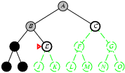
Depth-first search
Expand deepest unexpanded node
Implementation:
LIFO queue, i.e., put successors at front

Slide 39
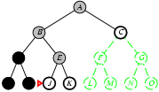
Depth-first search
Expand deepest unexpanded node
Implementation:
LIFO queue, i.e., put successors at front

Slide 40
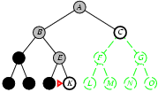
Depth-first search
Expand deepest unexpanded node
Implementation:
LIFO queue, i.e., put successors at front

Slide 41
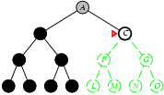
Depth-first search
Expand deepest unexpanded node
Implementation:
LIFO queue, i.e., put successors at front

Slide 42
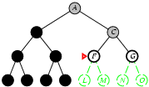
Depth-first search
Expand deepest unexpanded node
Implementation:
LIFO queue, i.e., put successors at front

Slide 43
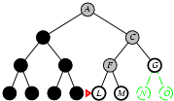
Depth-first search
Expand deepest unexpanded node
Implementation:
LIFO queue, i.e., put successors at front

Slide 44
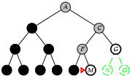
Depth-first search
Expand deepest unexpanded node http://aispace.org/search/
Implementation:
LIFO queue, i.e., put successors at front

Slide 45
Search Algorithm Properties

Slide 46
Search Algorithm Properties
Complete: Guaranteed to find a solution if one exists?
Optimal: Guaranteed to find the least cost path?
Time complexity?
Space complexity?
Cartoon of search tree:
b is the branching factor
m is the maximum depth
solutions at various depths
Number of nodes in entire tree?
1 + b + b² + …. b^{m} = O(b^{m})
1 node
b
…
b nodes
b² nodes
m tiers
b^{m} nodes
Notes:
Questions about search algoirthms.
Simple cartoony case – assume each node is state space connects to exactly b other nodes.
Since doing bound estimation, we’re correct as long as fewer than b.
Infinite?

Slide 47
Depth-First Search (DFS) Properties
What nodes DFS expand?
Some left prefix of the tree.
Could process the whole tree!
If m is finite, takes time O(b^{m})
How much space does the fringe take?
Only has siblings on path to root, so O(bm)
Is it complete?
m could be infinite, so only if we prevent cycles (more later)
Is it optimal?
No, it finds the “leftmost” solution, regardless of depth or cost
1 node
b
…
b nodes
b² nodes
m tiers
b^{m} nodes
Notes:
Process whole tree if goal is lower right.
Space: At each level, children of one node at most on fringe, so b. Times number of layers m. (Small!)

Slide 48
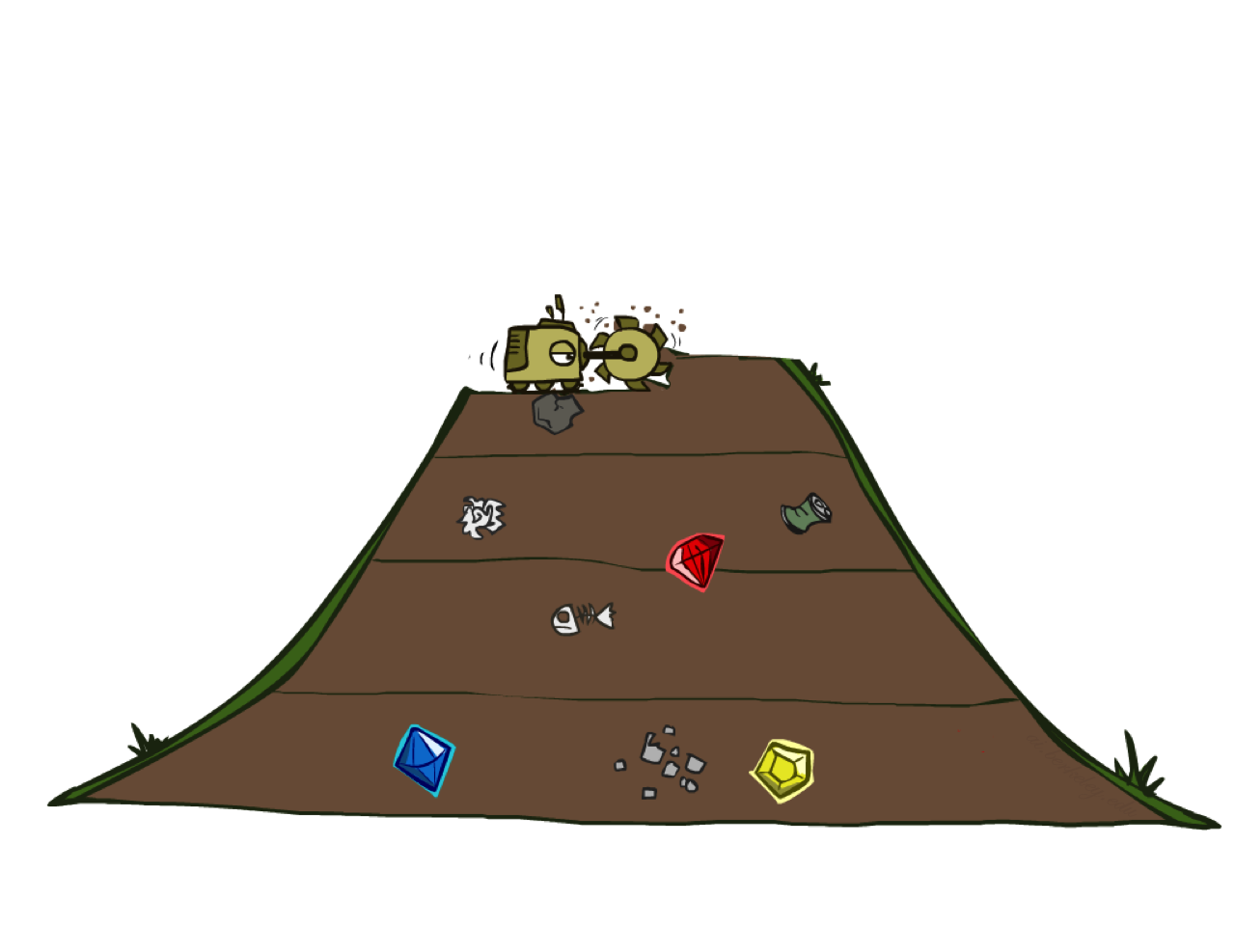
Breadth-First Search
Notes:
Another strategy. Layer by layer.
Strip-mining
BFS

Slide 49
Breadth-First Search
Strategy: expand a shallowest node first
Implementation: Fringe is a FIFO queue
a
G
b
c
d
e
f
S
h
p
q
r
S
d
e
p
Search
Tiers
b
c
e
h
r
q
a
a
h
r
p
q
f
p
q
f
q
c
G
q
c
G
a
a
Notes:
Same general algorithm. Shallowest node.
S D E P B C E H R Q

Slide 50
Breadth-First Search (BFS) Properties
What nodes does BFS expand?
Processes all nodes above shallowest solution
Let depth of shallowest solution be s
Search takes time O(b^{s})
How much space does the fringe take?
Has roughly the last tier, so O(b^{s})
Is it complete?
s must be finite if a solution exists
Is it optimal?
Only if costs are all 1 (more on costs later)
1 node
b
…
b nodes
s tiers
b² nodes
b^{s} nodes
b^{m} nodes
Notes:
Tier of best solution. If on right, b^s. Exponential Big.

Slide 51
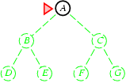
Breadth-first search
Expand shallowest unexpanded node
Implementation:
is a FIFO queue, i.e., new successors go at end

Slide 52
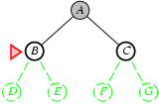
Breadth-first search
Expand shallowest unexpanded node
Implementation:
is a FIFO queue, i.e., new successors go at end

Slide 53
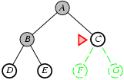
Breadth-first search
Expand shallowest unexpanded node
Implementation:
is a FIFO queue, i.e., new successors go at end

Slide 54
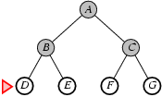
Breadth-first search
Expand shallowest unexpanded node http://aispace.org/search/
Implementation:
is a FIFO queue, i.e., new successors go at end

Slide 55
Quiz: DFS vs BFS
Notes:
Compare the two.

Slide 56
DFS vs BFS
When will BFS outperform DFS?
When will DFS outperform BFS?
Notes:
Think about it a bit. Discuss with neighbor.
BFS: Solutions not too far down.
DFS: need to get to the bottom. Memory constrained.

Slide 57

Video of Demo Maze Water DFS/BFS (part 1)
Notes:
L2D6 – Boats in water. States light up first time explored. Which one?
Breadth

Slide 58
Video of Demo Maze Water DFS/BFS (part 2)
Notes:
Depth
Leftmost not very good!

Slide 59
Iterative Deepening
Idea: get DFS’s space advantage with BFS’s time / shallow-solution advantages
Run a DFS with depth limit 1. If no solution…
Run a DFS with depth limit 2. If no solution…
Run a DFS with depth limit 3. …..
Isn’t that wastefully redundant?
Generally most work happens in the lowest level searched, so not so bad!
b
…
Notes:
Another strategy. Combine best of both.
DFS – successor says if deeper than one, stop.
Really common.

Slide 60
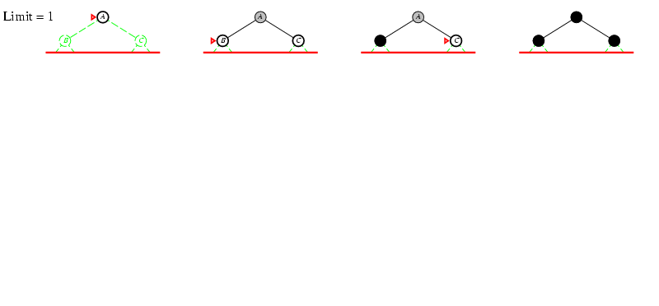
Iterative deepening search l =1

Slide 61
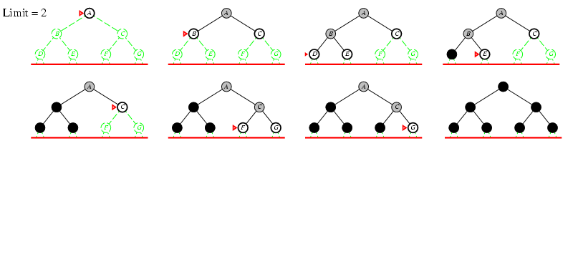
Iterative deepening search l =2

Slide 62
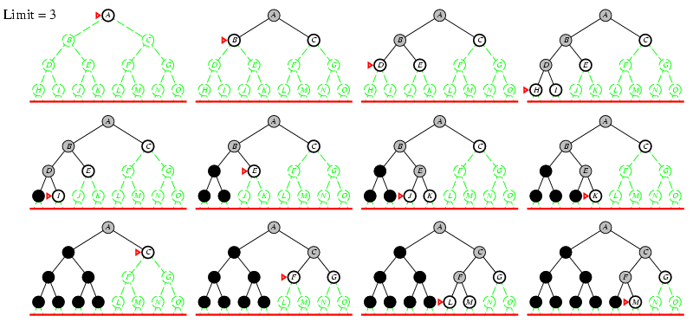
Iterative deepening search l =3

Slide 63
Cost-Sensitive Search
a
GOAL
2
2
b
c
3
2
1
8
2
e
d
f
3
9
8
2
START
h
1
4
2
p
4
r
15
q
BFS finds the shortest path in terms of number of actions.
It does not find the least-cost path. We will now cover
a similar algorithm which does find the least-cost path.
How?
Notes:
“Cost Search” What if you have costs associated with arcs? Could you rewrite with what we already know?
Lowest number of actions S->e->r->f->G. Expensive!

Slide 64

Uniform Cost Search
Notes:
Unfortunate name. It’s a “cost search” that is uniform, not a uniform cost.
Instead of depth, go by cost. Cheap things first, even if multiple actions.

Slide 65
Uniform Cost Search
2
G
a
Strategy: expand a cheapest node first:
Fringe is a priority queue (priority: cumulative cost)
b
c
1
8
2
2
e
3
d
f
9
8
2
S
h
1
1
p
q
r
15
0
S
d
3
e
9
p
1
b
4
e
5
h
17
r
11
q
16
c
11
Cost contours
a
6
a
h
13
r
7
p
q
f
p
q
f
8
q
c
G
q
c
a
11
G
10
a
Notes:
Like breadth first, but with costs. Label with cumulative cost.
Goal path not victory until try to expanded.
Contours show equal cost.

Slide 66
Uniform Cost Search (UCS) Properties
What nodes does UCS expand?
Processes all nodes with cost less than cheapest solution!
If that solution costs C* and arcs cost at least ε , then the “effective depth” is roughly C*/ε
Takes time O(b^{C*/ε}) (exponential in effective depth)
How much space does the fringe take?
Has roughly the last tier, so O(b^{C*/ε})
Is it complete?
Assuming best solution has a finite cost and minimum arc cost is positive, yes!
Is it optimal?
Yes! (Proof next lecture via A*)
b
c ≤ 1
…
C*/ε “tiers”
c ≤ 2
c ≤ 3
Notes:
Let’s say C* is 10 and minimum step size is 2. How deep in the tree? C*/e = 5. How many nodes is that?

Slide 67
Uniform Cost Issues
Remember: UCS explores increasing cost contours
The good: UCS is complete and optimal!
The bad:
Explores options in every “direction”
No information about goal location
We’ll fix that soon!
…
c ≤ 1
c ≤ 2
c ≤ 3
Start
Goal
[Demo: empty grid UCS (L2D5)]
[Demo: maze with deep/shallow water DFS/BFS/UCS (L2D7)]
Notes:
What if you know the goal?

Slide 68
Video of Demo Empty UCS
Notes:
L2D5
Then L2D7, Breadth, Uniform, Depth

Slide 69
Video of Demo Maze with Deep/Shallow Water --- DFS, BFS, or UCS? (part 1)
Notes:
Let students guess which one of the three it is. (This is BFS.)
L2D7 B U D

Slide 70


Your title here
Your title here
Your title here
Video of Demo Maze with Deep/Shallow Water --- DFS, BFS, or UCS? (part 1)
Presentations are communication tools that can be used as demonstrations, lectures, speeches, reports, and more.

Slide 71
Video of Demo Maze with Deep/Shallow Water --- DFS, BFS, or UCS? (part 2)
Notes:
Let students guess which one of the three it is. (This is UCS.)
expansion slows down when you hit deep water

Slide 72
Video of Demo Maze with Deep/Shallow Water --- DFS, BFS, or UCS? (part 3)
Notes:
Let students guess which one of the three it is. (This is DFS.)
<3 dfs

Slide 73

The One Queue
All these search algorithms are the same except for fringe strategies
Conceptually, all fringes are priority queues (i.e. collections of nodes with attached priorities)
Practically, for DFS and BFS, you can avoid the log(n) overhead from an actual priority queue, by using stacks and queues
Can even code one implementation that takes a variable queuing object

Slide 74
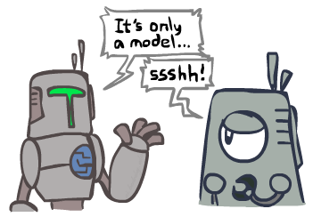
Search and Models
Search operates over models of the world
The agent doesn’t actually try all the plans out in the real world!
Planning is all “in simulation”
Your search is only as good as your models…
Notes:
All in your head.

Slide 75
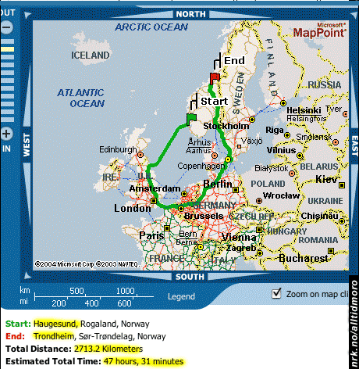
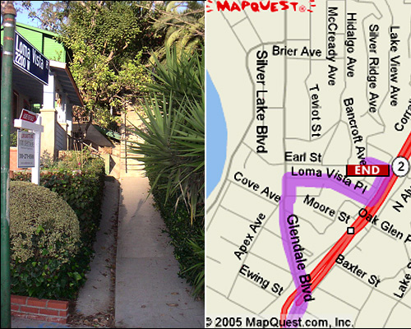

Search Gone Wrong?
Notes:
Next time – guided search where you know something about direction of solution.

